Slide 1

Project report
on
Secure password generator
A Dissertation submitted in partial fulfillment of the Academic requirements for the award of the degree of
Bachelor of Technology
In
Computer Science & Engineering (Cyber Security)
Submitted by
A Srinil Reddy (22H51A6202)
B Harshith (22H51A6207) C Krupalini (22H51A6213)
Under the esteemed Guidance of Dr.R.Venkateswara Reddy (Associate Professor and HOD,CSC)
Department of Cyber Security
CMR COLLEGE OF ENGINEERING & TECHNOLOGY
(Autonomous)
(NAAC Accredited with ‘A+’ Grade & NBA Accredited) (Approved by AICTE, Permanently Affiliated to JNTU Hyderabad)
KANDLAKOYA, MEDCHAL ROAD, HYDERABAD-501401

Slide 2
CMR COLLEGE OF ENGINEERING & TECHNOLOGY
(Autonomous)
(NAAC Accredited with ‘A+’ Grade & NBA Accredited) (Approved by AICTE, Permanently Affiliated to JNTU Hyderabad)
KANDLAKOYA, MEDCHAL ROAD, HYDERABAD-501401
DEPARTMENT OF CYBER SECURITY
CERTIFICATE
This is to certify that the Mini Project -1 report entitled “SECURE PASSWORD GENERATOR” being submitted by A Srinil Reddy(22H51A6202), B Harshith (22H51A6207), C Krupalini (22H51A621) in partial fulfillment for the award of Bachelor of Technology in Computer Science and Engineering (Cyber Security) is a record of bonafide work carried out his/her under my guidanceand supervision.
The results embodied in this project report have not been submitted to any other University or Institute for the award of any Degree.
R.Suhasini
Assistant Professor Dept. of CSC
Dr. R. Venkateswara Reddy Associate Professor & HOD Dept. of CSC

Slide 3
ACKNOWLEDGEMENT
With great pleasure I want to take this opportunity to express my heartfelt gratitude to all the people
`who helped in making this project a grand success.
I am grateful to R.Suhasini, Assistant Professor, Dept. of Computer Science and Engineering for her valuable suggestions and guidance during the execution of this project.
I would like to thank Dr. R. Venkateswara Reddy, Head of the Department of Computer Science and Engineering, for his moral support throughout the period of my study in CMRCET.
I am highly indebted to Major Dr. V.A. NARAYANA, Principal CMRCET, for giving permission to carry out this project in a successful and fruitful way.
I would like to thank the Teaching & Non- teaching staff of the Department of Computer Science and Engineering for their co-operation.
Finally, I express my sincere thanks to Mr. CH. GOPAL REDDY, Secretary, CMR Group of Institutions, for his continuous care. I sincerely acknowledge and thank all those who gave support directly and indirectly in the completion of this project work.
A Srinil Reddy (22H51A6202)
B Harshith
(22H51A6207)
C Krupalini
(22H51A6213)

Slide 4
ABSTRACT
In today's digital era, where cyber threats are prevalent, protecting online accounts with strong passwords is essential.
Secure Password Generator provides a reliable solution by generating highly secure passwords using advanced algorithms and encryption techniques.
With its user-friendly interface, individuals can easily create customized strong passwords. By utilizing Secure Password Generator, users enhance the security of their online accounts, reducing the risk of unauthorized access and potential data breaches.
Whether for personal or professional use, Secure Password Generator ensures peace of mind by safeguarding critical digital assets against malicious actors.
This tool not only ensures peace of mind but also safeguards critical digital assets against malicious actors, promoting a proactive approach to online security.

Slide 5
Table Of Content
CHAPTERS | DESCRIPTION | PAGE NUMBERS
1 | INTRODUCTION | 2
1.1 | AIM | 3
1.2 | SCOPE | 4
2 | LITERATURE REVIEW | 6
3 | EXISTING SOLUTIONS | 8
4 | PROPOSED SYSTEM | 11
4.1 | REQUIREMENT ANALYSIS | 12
4.1.1 | HARDWARE REQUIREMENTS | 12
4.1.2 | SOFTWARE REQUIREMENTS | 12
4.2 | MERITS AND DEMERITS | 13
5 | DESIGN DESCRIPTION | 15
5.1 | CONCEPTUAL DESIGN | 15
6 | IMPLEMENTATION AND DISCUSSION | 16
6.1 | IMPLEMENTATION | 17
7 | RESULT | 20
8 | CONCLUSION AND FUTURE ENHANCEMENT | 21
8.1 | CONCLUSION | 21
8.2 | ENHANCEMENT | 21
8.3 | REFERENCES | 24

Slide 6
CHAPTER 1
1

Slide 7
1. INTRODUCTION
A Secure Password Generator is a tool designed to create strong, unpredictable passwords to enhance the security of user accounts and data.
Unlike common passwords, which are often easy to guess or crack, secure password generators use complex algorithms to produce random combinations of characters, including letters, numbers, and symbols.
These passwords are typically long and lack any predictable patterns, making them highly resistant to brute-force attacks and other hacking methods.
By using a secure password generator, individuals and organizations can significantly improve their cybersecurity posture, protecting against unauthorized access and data breaches.
2

Slide 8
1.1 AIM
The aim of a Secure Password Generator is to provide users with robust, random passwords that significantly enhance the security of their digital accounts and sensitive information.
It strives to minimize the risk of password-related breaches by ensuring that generated passwords are complex, unique, and difficult to guess or crack.
By automating the creation of secure passwords, the tool helps users adhere to best practices in cybersecurity, reducing the likelihood of unauthorized access and protecting against various cyber threats.
3

Slide 9

1.2 SCOPE
Utilizing algorithms to create random combinations of characters, including upper and lower case letters, numbers, and special symbols.
Allowing users to specify the length and complexity of the passwords, including the inclusion or exclusion of certain character types.
Providing an intuitive interface for easy use, ensuring that even non-technical users can generate secure passwords effortlessly.
Ensuring the tool can be used on various devices and operating systems, including desktop computers, smartphones, and tablets.
Web Development
Web development, also known as website development, refers to the tasks associated with creating, building and maintain websites and web applications that run online on a browser, it may, however, also include web design, web programming, and database management.
Web development is closely related to the job of designing the features and functionality of apps (web design). The basic tools involved in web development are programming languages like HTML (Hyper Text Markup Language), CSS (Cascading Style Sheets), JavaScript, Flask.

Slide 10
CHAPTER 2

Slide 11
2. LITERATURE REVIEW
Discuss the critical role of strong passwords in protecting digital assets and personal information.
Summarize different types of attacks (e.g., brute force, dictionary attacks, phishing) that target passwords.
Compare methods of password generation, focusing on the strengths and weaknesses of each approach.
Propose frameworks or criteria for evaluating the effectiveness of password generators.

Slide 12
CHAPTER 3

Slide 13
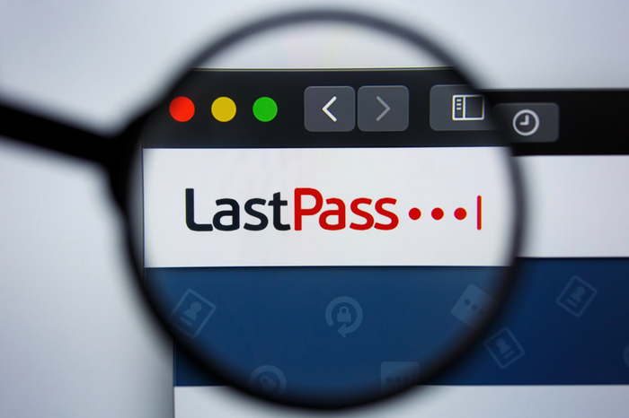

3. EXISTING SOLUTION
1. LastPass:
LastPass is a popular password manager that offers a built-in password generator. It allows users to generate strong, unique passwords for their accounts and stores them securely in an encrypted vault.
Fig 1: Lastpass
2. Dashlane:
Dashlane offers a password manager with a password generator feature. Users can customize password settings such as length, character types, and readability.
Fig 2: Dashlane

Slide 14

3. KeePass:
KeePass is an open-source password manager that includes a password generator tool. It generates strong passwords based on user-defined criteria and stores them in an encrypted database
Fig 3: Key Pass

Slide 15
CHAPTER 4

Slide 16
6. PROPOSED SYSTEM
We will first create a front end for the users to enter the website and access it using html css and Javascript.
We will deploy the Cryptographically Secure Pseudo-Random Number Generators (CSPRNGs) algorithms using javascript.
This Algorithm uses random character generation . The user will have an option to select different characters used to generate the password like numbers , capital letters , special characters ,etc.
The Website will display all the top 5 password ranked by strength to the user . The user can choose their preferred password in their database using MongoDB.
The Website uses NodeJs and ExpressJs for handling the backend servers and deployed using Netlify.
The users can also provide their keywords , incase they want some password related to them.

Slide 17

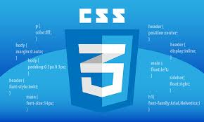
4.1 REQUIREMENT ANALYSIS
Software Requirements
FRONTEND: HTML , CSS , BOOTSTRAP
LANGUAGE : JAVASCRIPT
BACKEND : NODEJS, EXPRESSJS
DATABASE : MONGODB
DEPLOYMENT : NETLIFY
Hardware Requirements
COMPUTER

Slide 18
MERITS AND DEMERITS
Merits:
Enhanced Security
Reduced Human Error
Compliance with Security Standards
Demerits:
Usability Challenges
If users rely heavily on password managers, a compromise of the manager can lead to exposure of all stored passwords.
Incorrect implementation of cryptographic algorithms or other security measures can weaken the effectiveness of the password generator.

Slide 19
CHAPTER 5
14

Slide 20
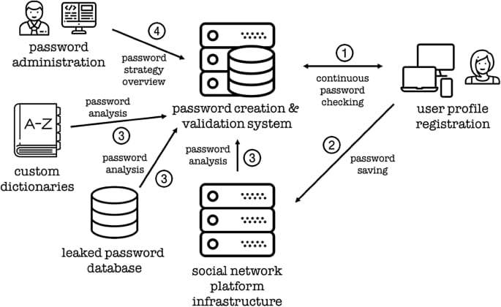
7. DESIGN DESCRIPTION
5.1 CONCEPTUAL DESIGN
The diagram shows the steps involved in SECURE PASSWORD GENERATOR
Fig 6: Steps for VAPT
15

Slide 21
CHAPTER 6
16

Slide 22
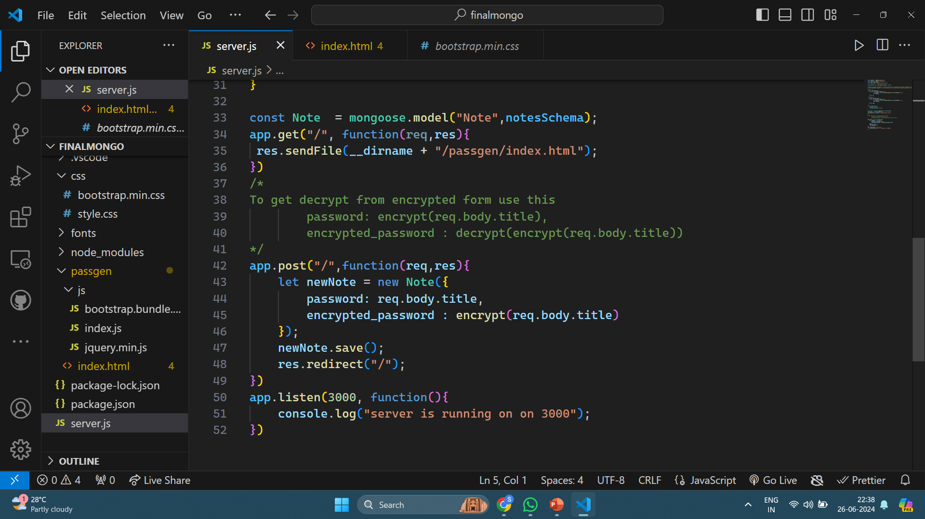
IMPLEMENTATION AND DISCUSSION
IMPLEMENTATION
Open the node.js file to run it in visual studio code
Fig 6: Reconnaissance
17

Slide 23
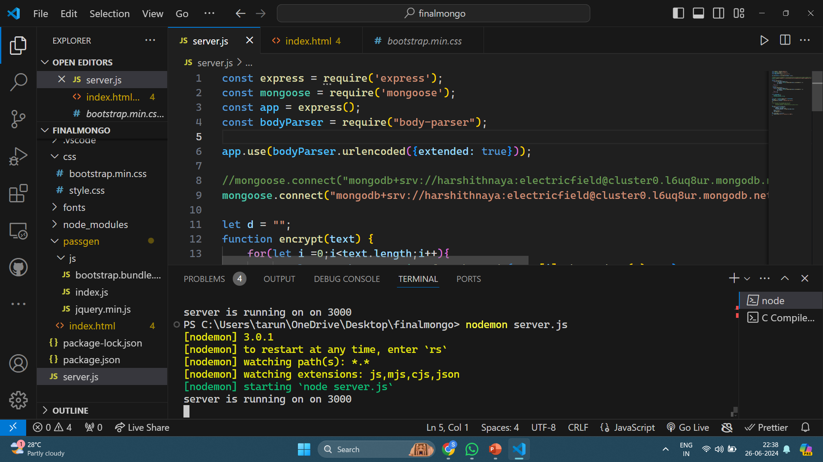
Run the file:
Command : nodemon server.js → use this in terminal in vs code
Fig 7:Scanning
17

Slide 24
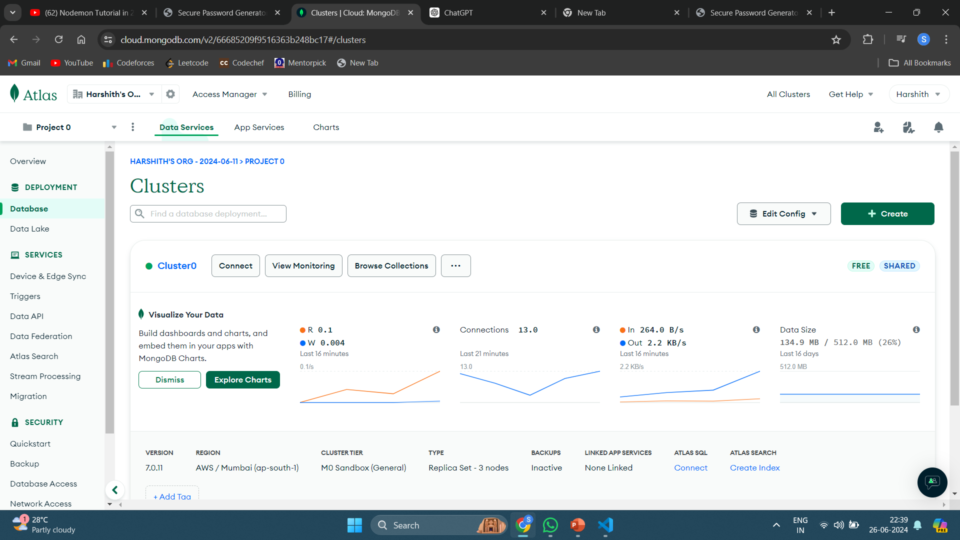
OPEN MONGODB AND USER DATABASE:
Fig 8
OPEN LOCALHOST:3000 IN WEB SERVER TO RUN THE APPLICATION
17

Slide 25
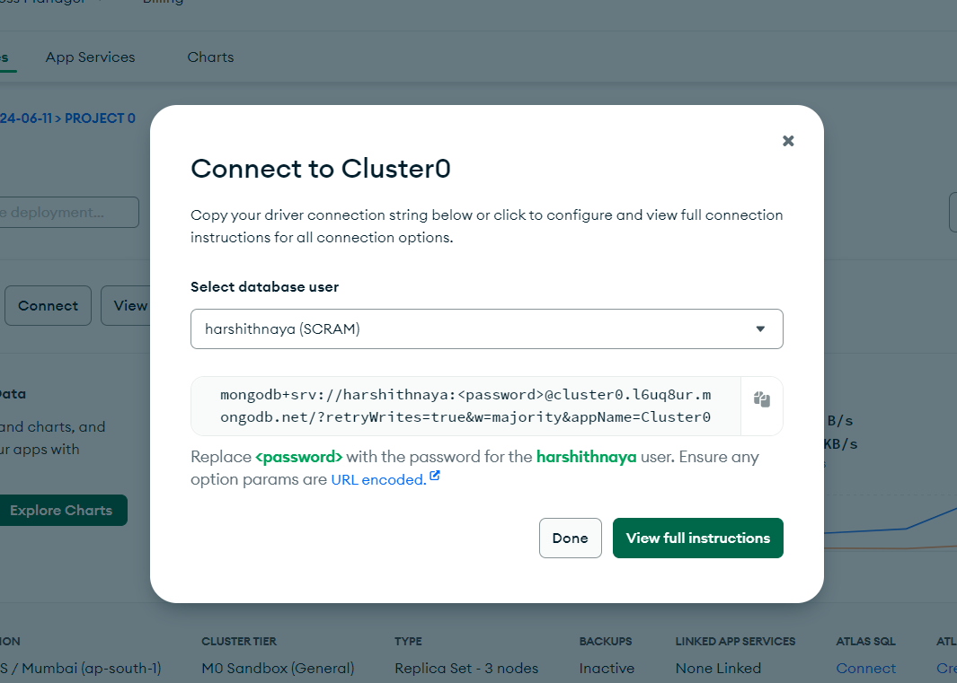
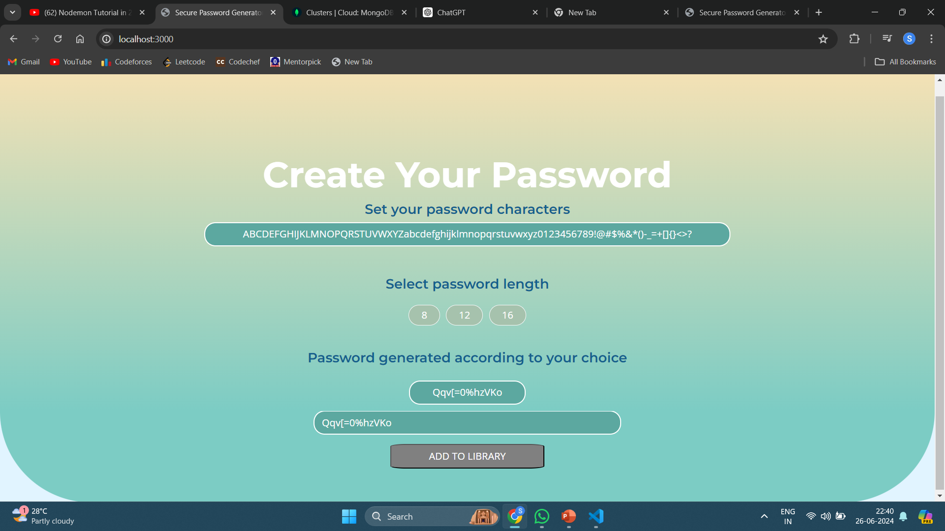
Connect to the node.js and mongodb using the provided link
Fig 9
Connect and open localhost:3000
Fig 10
17

Slide 26
CHAPTER 7
17

Slide 27
9. RESULT
After we open our web application our interface will be opened and we will have an option to select any length from 8 ,12,16 characters of password and if we click generate,it will generate us strong and random password.
Fig 12
17

Slide 28
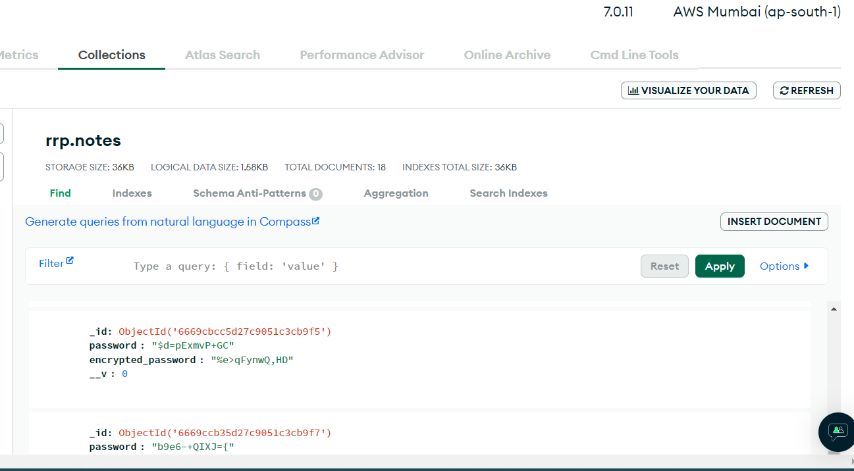
ACCESSING THE PASSWORDS AND VIEWING THE DATABASE
Fig 13
The password has been generated and stored securely in encrypted form in out local database
17

Slide 29
CHAPTER 8
17

Slide 30
10. CONCLUSION AND FUTURE ENHANCEMEMT
8.1. CONCLUSION
Secure password generators are indispensable tools in the modern cybersecurity landscape, offering a robust defense against many common threats. By creating complex and unique passwords, these tools significantly reduce the risk of unauthorized access resulting from weak or reused passwords. However, while they enhance security, they also present several challenges that need to be addressed for effective implementation.
8.2 FUTURE ENHANCEMENTS
Developing more intuitive and user-friendly interfaces for password generators to make them accessible to all users, including those who are not tech-savvy.
Implementing algorithms that suggest passwords based on the context of use, ensuring both security and memorability without sacrificing complexity.
25

Slide 31
8.3 REFERENCES
Florêncio, D., & Herley, C. (2007):A large-scale study of web password habits. Proceedings of the 16th international conference on World Wide Web.
Komanduri, S., Shay, R., Kelley, P. G., Mazurek, M. L., Bauer, L., Christin, N., Cranor, L. F., & Egelman, S. (2011): measuring the effect of password-composition policies. Proceedings of the SIGCHI Conference on Human Factors in Computing Systems.
Ur, B., Kelley, P. G., Komanduri, S., Lee, J., Maass, M., Mazurek, M. L., & Shay, R. (2012):The effect of strength meters on password creation. Proceedings of the 21st USENIX Security Symposium.
26

